Slide 1
Article Name :
Evolocumab and Clinical Outcomes in Patients
with Cardiovascular Disease
Author: S. Sabatine, P. Giugliano, C. Keech et al
Journal: The new England journal of medicine
Published on: March 17, 2017
Pharmacotherapy I
Noura Albuholaiqa

Slide 2
Background information
Evolocomb is a human monoclonal that inhibits the enzyme protein convertase subtilisin-kexin type 9(PCSK9)
Evolocomb also lowers low-density lipoprotein (LDL) cholesterol levels by sixty percent
Genetics studies indicates that the carriage of PCSK9 loss-of-function alleles is usually characterized by the reduced risks of myocardial infarction and lower levels of LDL cholesterol
Low-Density lipoproteins (LDL; Bad Cholesterol) carry cholesterol to all cells in the body, including the arteries that supply blood to the heart
Elevations in LDL places a patient at increased risk for atherogenic disease, including coronary, cerebrovascular and peripheral artery disease
With each of these conditions, fatty deposits accumulate in the arteries (atherosclerosis).

Slide 3
Evolocumab is PCSK9 inhibitor that lowers LDL-Cholesterol by 60%
the magnitude of benefit of evolocumab in reducing the risk of major coronary events, stroke, and urgent coronary

Slide 4
Objective:
The FOURIER trial tested the clinical efficacy and safety of Evolocumab when added to high-intensity or moderate-intensity statin therapy in patients with clinical ASCVD
Design:
FOURIER trial
Randomized, double-blind, placebo-controlled, multinational clinical trial.
The protocol and amendments were approved by the relevant ethics committees at all participating sites
.

Slide 5
Length of Study
Randomization from February 2013 through June 2015.
Median duration of follow-up was 26 months
All efficacy analysis were conducted on an intention-to-treat basis

Slide 6
Outcomes
  Primary end point: cardiovascular death, myocardial infarction, stroke, hospitalization for unstable angina, or coronary revascularization.
  Key secondary end point: cardiovascular death, myocardial infarction, or stroke.
  Safety was assessed through collection of data on adverse events and central laboratory testing.
  A central clinical-events committee, whose members were unaware of study-group assignments and lipid levels, determined all potential efficacy end-point events and cases of new-onset diabetes.

Slide 7
Interventions
  Eligible patients were randomly assigned in a 1:1 ratio to receive subcutaneous injections of:
    Evolocumab or placebo.
    Either 140 mg every 2 weeks or 420 mg every month, according to patient preference.
Monitoring of adherence not specified

Slide 8
Method
Patients at 1242 sites in 49 countries underwent randomization.
Randomization was double-blinded using a central computerized system.
  Stratification according to final screening LDL cholesterol level and region.
  LDL < 85 or ≥85 mg/dL [<2.2 or ≥2.2 mmol per liter]

Slide 9
Exclusion Criteria (ClinicalTrials.gov) | Inclusion Criteria
NYHA class III or IV, or last known LVEF < 30% Uncontrolled hypertension Uncontrolled or recurrent ventricular tachycardia Untreated hyperthyroidism or hypothyroidism Homozygous familial hypercholesterolemia | Age 40-85 years Clinical ASCVD - Myocardial infarction, nonhemorrhagic stroke, or symptomatic peripheral artery disease. LDL ≥ 70 mg/dL or HDL ≥ 100 mg/dL while on optimal lipid-lowering therapy (Atorvastatin 20 mg QD or its equivalent, with or without ezetimibe)

Slide 10
Statistical Analysis
90% power to detect a 15% relative risk reduction with Evolocumab as compared with placebo.
  1630 key secondary end points required
Cox proportional-hazards model
  Hazard ratios and 95% confidence intervals.
  Stratification factors as covariates.
Time-to-event analysis
P values for were calculated with the use of log-rank tests.
Notes:
The Cox proportional-hazards model (Cox, 1972) is essentially a regression model commonly used statistical in medical research for investigating the association between the survival time of patients and one or more predictor variables
In statistics, the log-rank test is a hypothesis test to compare the survival distributions of two samples. It is a nonparametric test and appropriate to use when the data are right skewed and censored.

Slide 11

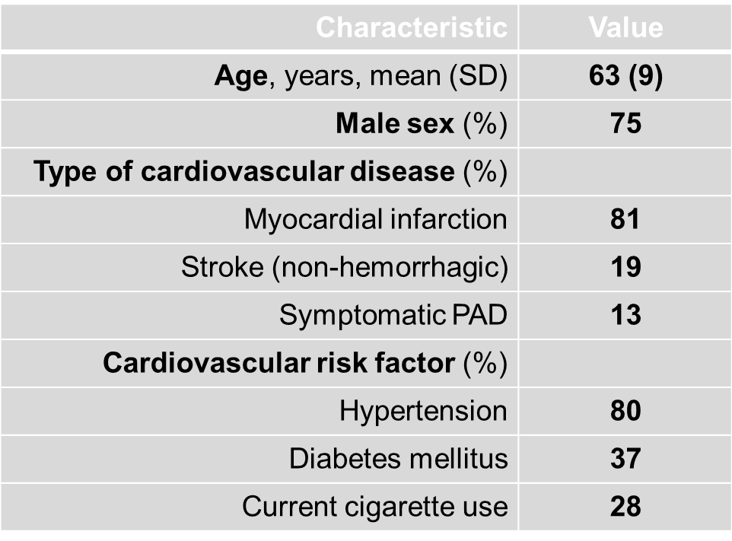
Baseline Characteristics (N=27,564 [Evolocumab N=13,784 and Placebo N=13,780])
  Demographics
    Mean age 63 years, 75% male, 85% white, mean weight 85 kg
  Region
    17% North America, 62% Europe, 7% Latin America, 14% Asian and African
  Type of atherosclerosis (history)
    81% MI, 19% nonhemorrhagic stroke, 13% peripheral artery disease
  Cardiovascular risk factors
    80% hypertension, 37% diabetes mellitus, 28% smokers

Slide 12
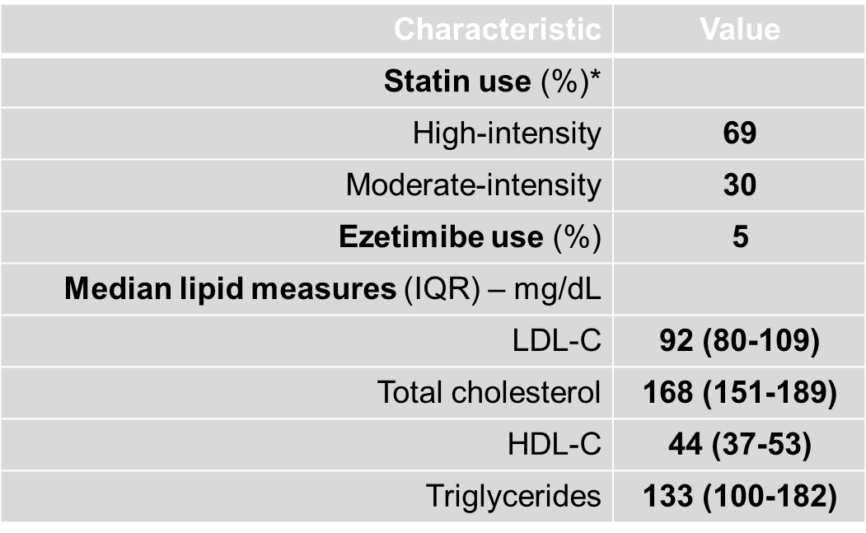
  Statin use
    69% high-intensity statin, 30% moderate-intensity statin
  Ezetimibe
    5% on ezetimibe
  Other cardiovascular medications
    92% aspirin, P2Y₁₂ inhibitor, or both, 76% β-blocker, 78% ACEI/ARB, aldosterone antagonist or both
  Median lipid measures
LDL 92 mg/dL, TC 168 mg/dL, HDL 44 mg/dL, TG 134 mg/dL, Lp(a) 37 nmol/L

Slide 13
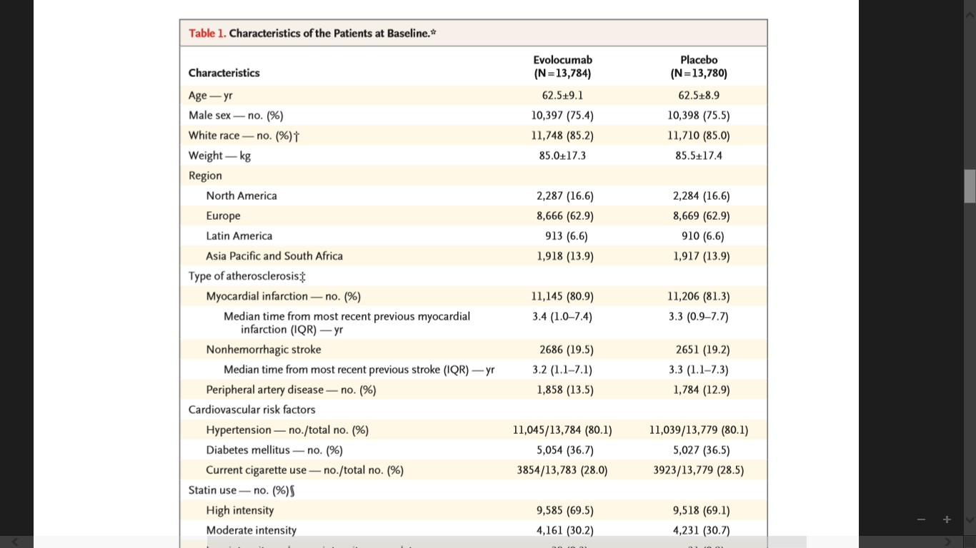
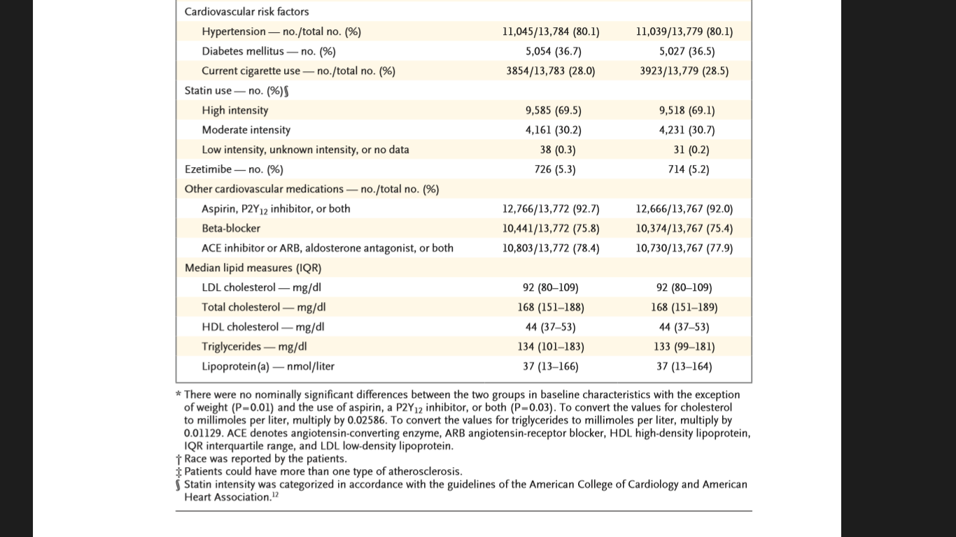

Slide 14
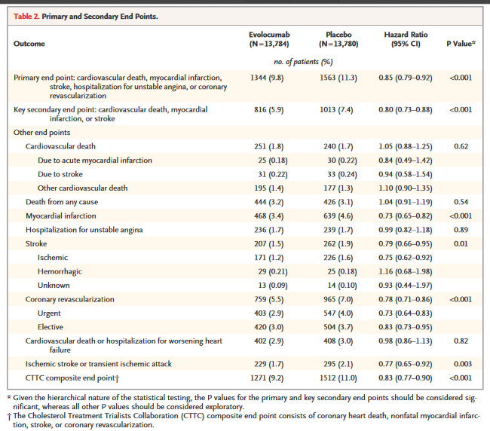
Results: Primary and secondary efficacy endpoint

Slide 15
Adverse Events
No significant between two groups differences were seen in the overall rates of :
- adverse events
- serious adverse events
- adverse events thought to be related to the study agent and leading to discontinuation of the study regimen
The large majority of reactions (approximately 90% in each group) were classified as mild
injection-site reaction
- only 0.1% of the patients in each group stopped receiving the study agent

Slide 16
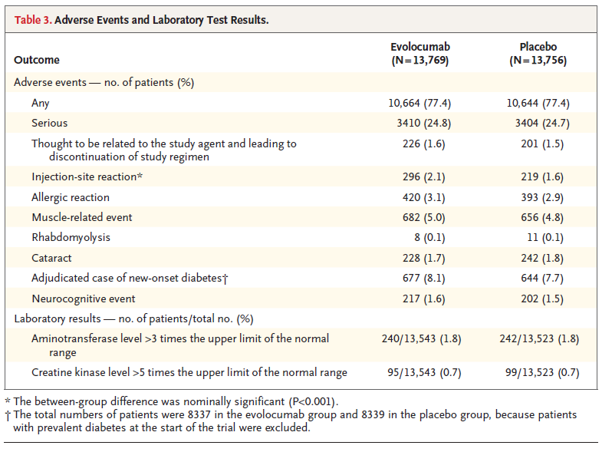

Slide 17
Discussion & Conclusion
In this study, 27 564 patients with established atherosclerotic cardiovascular disease and LDL cholesterol levels >_70 mg/dL (1.8 mmol/L) were used as the study population
Despite optimized lipid-lowering therapy (mostly intense statin treatment) were randomized to treatment with evolocumab (a monoclonal antibody inhibiting PCSK9; either 140 mg every 2 weeks or 420 mg monthly) or matching placebo.
A significant 59% reduction in LDL cholesterol levels was observed with evolocumab treatment when compared with placebo at 48 weeks from a median LDL cholesterol at baseline of 92 mg/dL (2.4 mmol/L) to 30 mg/dL (0.78 mmol/L)
Importantly, during a median follow-up time of 26 months, a significantly
reduced risk of cardiovascular events (15% of the primary composite and 20% of the key secondary end points ) was observed in patients treated with PCSK9 inhibition
FOURIER trial provided insight into the benefit of decreasing LDL cholesterol levels to median levels lower than those in previous trials..

Slide 18

Journal
Journal of the New England Journal of Medicine (NEJM)
Impact factor 2017/2018
79.258

Slide 19
Critical Appraisal
Background and Rationale: Satisfactory
The background is presented appropriately and it is justified by the author as he mentioned that Evolocumab also lowers low-density lipoprotein (LDL) cholesterol levels by sixty percent
Previous trials
previous trials of more intensive LDL cholesterol–lowering therapy as compared with moderate-intensity statin therapy, it was found that there was no effect of additional lowering of LDL cholesterol levels on cardiovascular mortality.
The rate of use of evidence-based cardiovascular pharmacotherapies that lower cardiovascular mortality was very high in FOURIER,
Objectives: Satisfactory
The objective of the study was stated clearly about the FOURIER trial tested the clinical efficacy and safety of Evolocumab when added to high-intensity or moderate-intensity statin therapy in patients with clinical ASCVD

Slide 20
Control of Treatment-Related Bias: Satisfactory
The study was double blinded
The drugs, doses , regimen, and time of administration was clearly mentioned and outlined
patients were randomly assigned in a 1:1 ratio to receive subcutaneous injections of evolocumab
Random assignment done through computer generated random numbers
Description of the Study: Satisfactory
The side effects of Evolocumab such as the injection reaction and allergic reaction were clearly indicated in a table and the most frequently adverse effects of drugs were presented clearly with the percentage of patients who experienced those adverse effects
The duration of the study was clearly stated
pharmacological treatment of Evolocumab were clearly stated and explained

Slide 21
Statistical analysis: Satisfactory
The primary analysis of the data was done with treating the population which reflects the real clinical population
The study used effective and Appropriate statistical tests to analyze the data
Synthesis of Data: Satisfactory
The study approach used to answer the research question and prove the hypothesis was concise and clear
All results of the study were clearly presented on graphs and tables and they were easy to follow and comprehend
Focus of the study: Satisfactory
The author stated the conclusion clearly and was related to the research question of the study
Application of the study
The study has was sufficiently presented this means the sample size is adequate to represent the population, however the following limitations were noted:
  Short duration of follow-up
    Limits evaluation of long term benefits of Evolocumab.
  Potential for bias due to manufacturer/sponsor (Amgen) of Evolocumab (Rapatha).
  Baseline characteristics were slightly skewed. (Mostly male and white)Weakens external validity

Slide 22
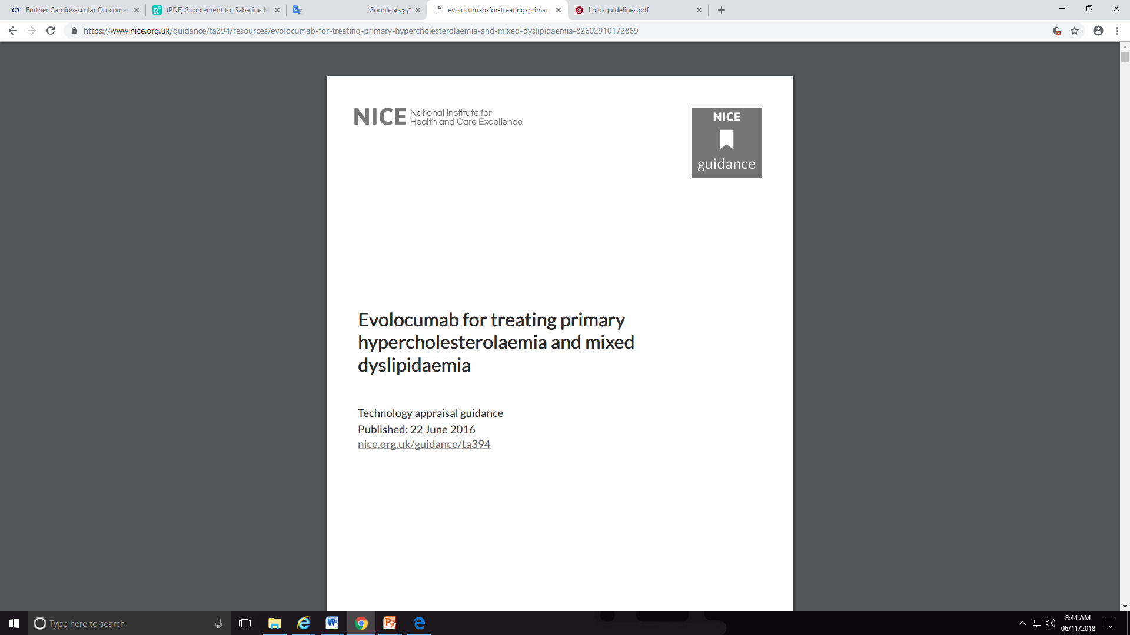
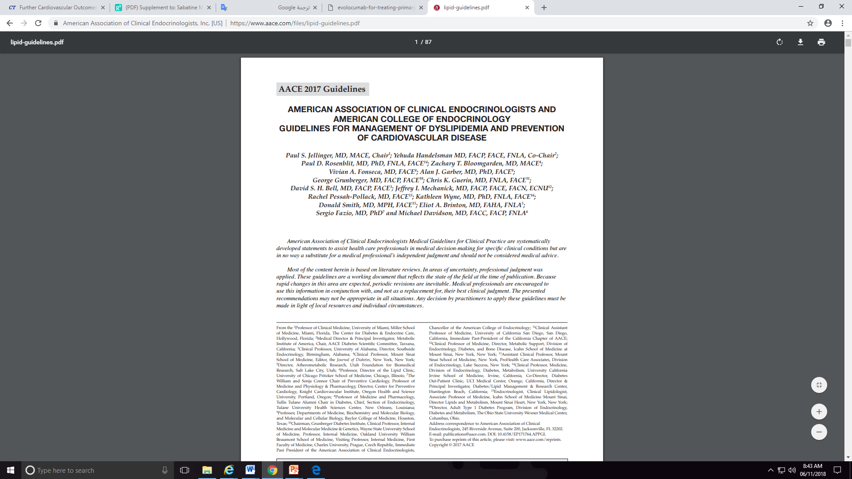

Slide 23

THANK YOU

